Slide 1
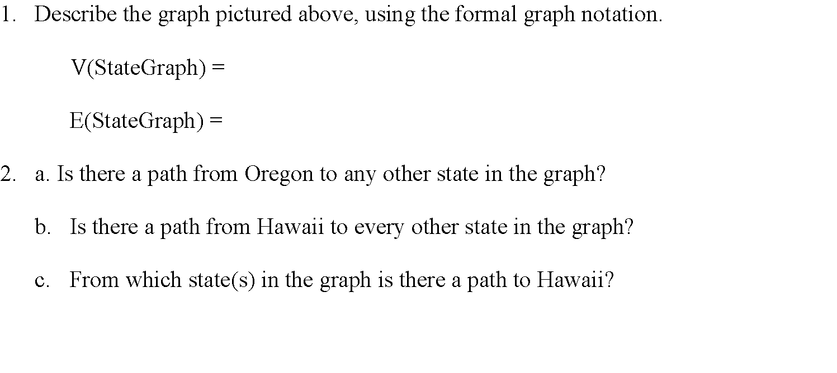
CMSC204
Kartchner
V(StateGraph) = {Oregon, Alaska, Texas, Hawaii, Vermont, NewYork, California}
E(StateGraph) = {(Alaska, Oregon), (Hawaii, Alaska), (Hawaii, Texas), (Texas, Hawaii), (Hawaii, California), (Hawaii, New York), (Texas, Vermont), (Vermont, California), (Vermont, Alaska)}
1. Draw the StateGraph
alaska
Oregon
texas
hawaii
california
vermont
newyork
V(StateGraph) = {Oregon, Alaska, Texas, Hawaii, Vermont, NewYork, California}
E(StateGraph) = {(Alaska, Oregon), (Hawaii, Alaska), (Hawaii, Texas), (Texas, Hawaii), (Hawaii, California), (Hawaii, New York), (Texas, Vermont), (Vermont, California), (Vermont, Alaska)}
no
no
alaska, texas, california, new york

Slide 2
a. Show the adjacency matrix that would describe the edges in the graph. Store the vertices in alphabetical order
States
Alaska
California
Hawaii
NewYork
Oregon
Texas
Vermont
0 | 0 | 0 | 0 | 1 | 0 | 0
0 | 0 | 0 | 0 | 0 | 0 | 0
1 | 1 | 0 | 1 | 0 | 1 | 0
0 | 0 | 0 | 0 | 0 | 0 | 0
0 | 0 | 0 | 0 | 0 | 0 | 0
0 | 0 | 1 | 0 | 0 | 0 | 0
1 | 1 | 0 | 0 | 0 | 1 | 0
3. b. Show the adjacency lists
that would describe the edges in the graph
alaska, texas
california
hawaii, alaska, california,NewYork, Texas
NewYork
Oregon
Texas,hawaii
vermont, alaska, california, Texas

Slide 3
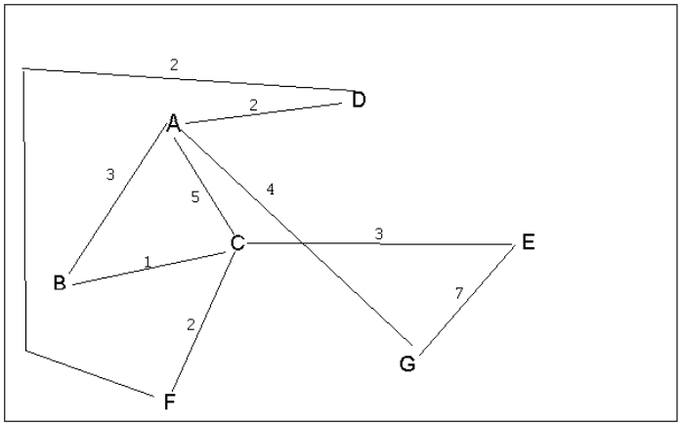
4 a. Which of the following lists the graph nodes in depth first order beginning with E?
A) E, G, F, C, D, B, A
B) G, A, E, C, B, F, D
C) E, G, A, D, F, C, B
D) E, C, F, B, A, D, G
4 b. Which of the following lists the graph nodes in breadth first order beginning at F?
A) F, C, D, A, B, E, G
B) F, D, C, A, B, C, G
C) F, C, D, B, G, A, E
D) a, b, and c are all breadth first traversals

Slide 4
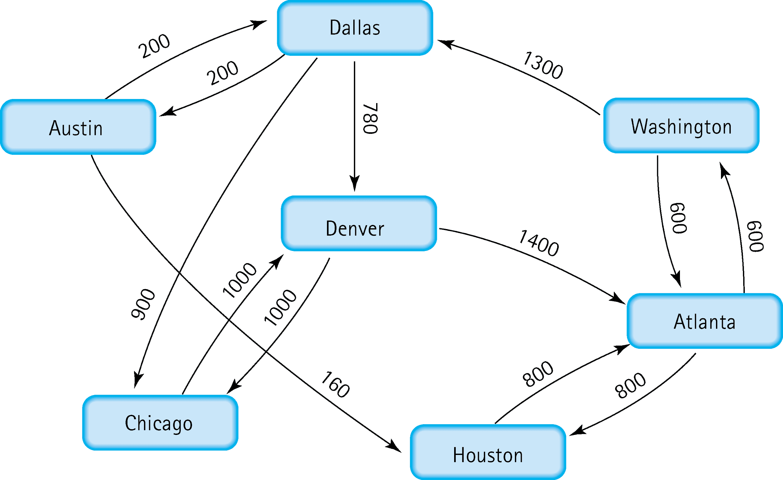
5. Find the shortest distance from Atlanta to every other city
Atlanta -> Washinton cost: 600
Atlanta -> Houston cost: 800
Atlanta -> Dallas cost: 1900
Atlanta -> Denver cost: 2680
Atlanta -> Austin cost: 2100
Atlanta -> Chicago cost: 2800

Slide 5
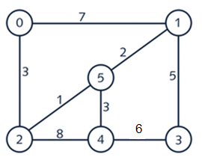
6. Find the minimal spanning tree using Prim’s algorithm. Use
0 as the source vertex . Show the steps.
{0,inf,inf,inf,inf,inf}
{0,2,inf,inf,inf,inf}
{0,2,5,inf,inf,inf}
{0,2,5,1,inf,inf}
{0,2,5,1,4,inf}
{0,2,5,1,4,3}

Slide 6
7. Find the minimal spanning tree using Kruskal’s algorithm.
Show the weights in order and the steps.
include 2-5, weight 1
include 5-1, weight 2
include 5-4, weight 3
include 0-2, weight 3
include 1-3, weight 5

Slide 7
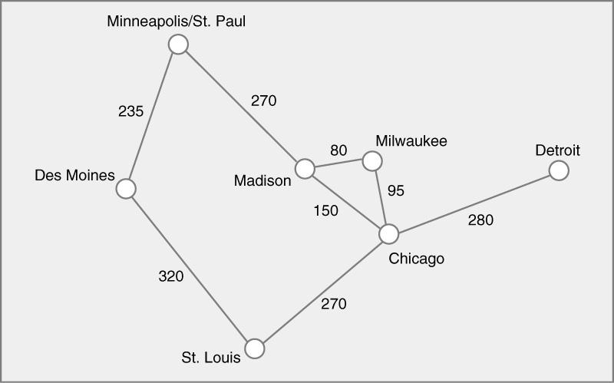
8. Find the minimal spanning tree using the algorithm you prefer. Use
Minneapolis/St. Paul as the source vertex

Slide 8
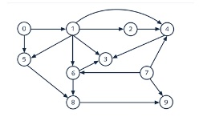
9. List the nodes of the graph in a breadth first topological ordering. Show the
steps using arrays predCount, topologicalOrder and a queue
0
1,5
6,8,2,3,4
9
7

Slide 9
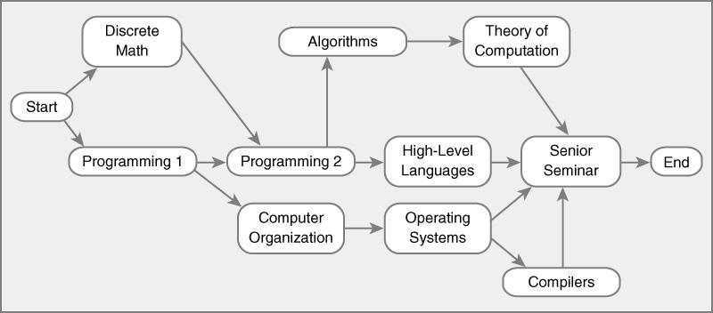
10. List the nodes of the graph in a breadth first topological ordering.
start
discrete math, programming 1
programming 2, computer organization
algorithms, high level languages ,operating systems
compilers, senior seminar, theory of computation

